Slide 1
Global DRG Implementations: What the evidences say?
Dr. Ahmad Okasha
Associate Professor
Canadian University Dubai

Slide 2
Contents
Background on the development of DRG Groups
International DRG implementations—Lesson Learned.
What to expect in Dubai?

Slide 3
Hospital Payment Types
Fee for service
Diagnostic Related Groups/Groupings
Capitated payments
Outcomes based payments

Slide 4
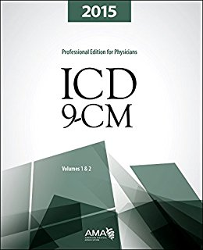
International Classification of Diseases
ICD is a WHO classification of diseases which is widely used by hospitals, physicians, insurance companies, and regulator agencies
ICD-9-Current Modifications
ICD-10
ICD-11

Slide 5
Clinical Procedure Codes
CPT (Current Procedural Terminology)
The most common used CPT code is Evaluation and Management: 99201 – 99499.

Slide 6
The Story of Diagnostic Related Groups
Prior to 1984, US hospitals charged based on utilizations and fee for services
They were incentivized to keep patients and add more services
Hospital costs increased at an alarming rate

Slide 7
Story of DRG
DRG started as a health utilization review study at Yale
DRG was based on ICD9-CM, implemented first in New Jersey, and then adopted by CMS.
The initial goal was classify inpatient conditions into sub groups for the purpose improving quality.
It was then used as a payment system.
The DRG classification system divides possible diagnoses into 25 major body systems and subgroup them into 500+ groups for the purpose of Medicare reimbursement
DRG classification include diagnoses that are related to an organ first then resource intensity

Slide 8
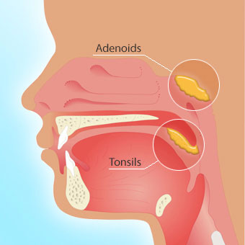
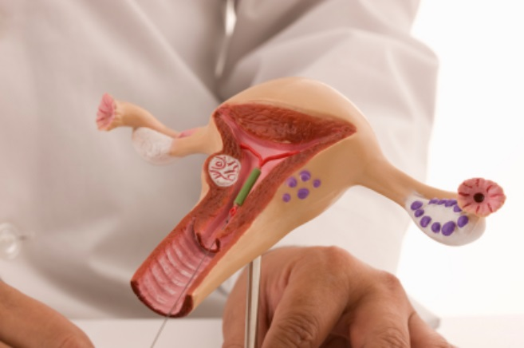
D&C or a Tonsillectomy procedures are similar in terms of resource intensity. However, they are related to different organs. They need to be in separate DRGs.
Notes:
Dilation and curettage (D&C) is a procedure to remove tissue from inside your uterus.

Slide 9
The purpose of DRG
The US government implemented DRG for the proposes of:
Comparisons of costs for the same DRG between hospitals would allow hospital staff to improve efficiency of non clinical services, and clinical effectiveness
By forcing hospitals to operate more efficiently, and by forcing physicians to organize goods and services more effectively, prospective payment system was to start a process by which Medicare's budget could be capped and controlled.

Slide 10
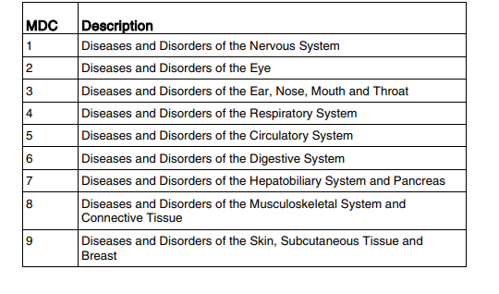
DRG Formation Process
DRG would be started by forming 25 distinct principles diagnosis areas such as

Slide 11
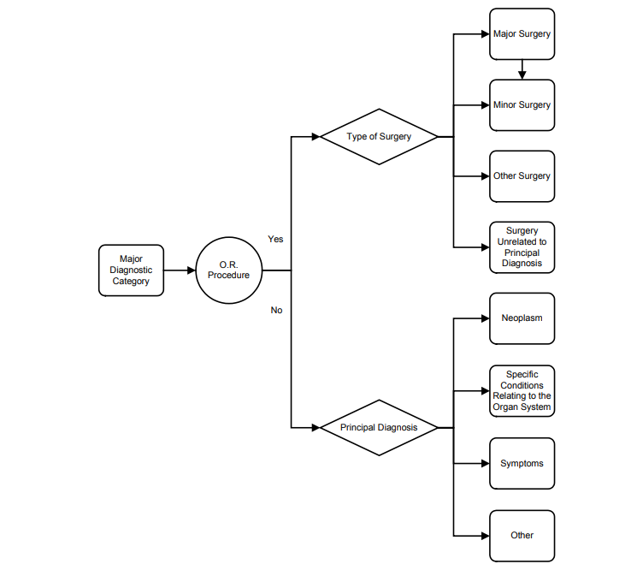
Design of DRG System
CMS, 2018
Notes:
Neoplasm related to cancer

Slide 12
Update of DRG System
Following the initial DRG formation, 3M Health Information, update version 2 and related versions.

Slide 13
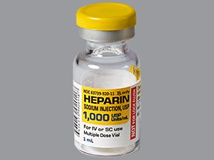
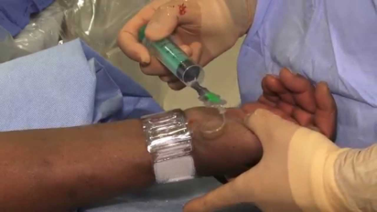
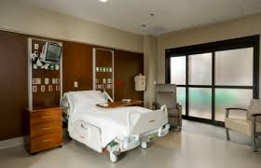
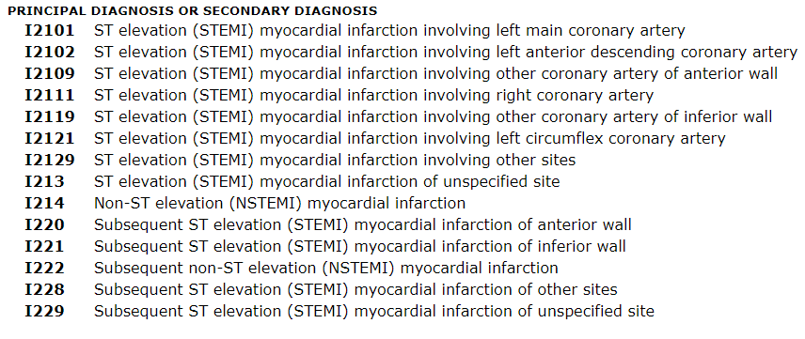
DRG 281 ACUTE MYOCARDIAL INFARCTION, DISCHARGED ALIVE W CC
ICD-10
Activity based costing
DRG 281
Cost plus Charges
Fixed Payment
Retrospective
Prospective
Notes:
DRG 281 ACUTE MYOCARDIAL INFARCTION, DISCHARGED ALIVE With Cardiac Catheterization

Slide 14
What do DRGs Cover?
Types of services covered by a DRG payment include:
Nursing care
Technician services
Therapies
Laboratory
Pharmaceuticals
Room
Meals
Etc.
Physician care
Radiology

Slide 15
http://eurodrg.eu

Slide 16
Global DRG Implementations
ICD-10
USA
Europe
Australia---AR-DRG
Thailand
Activity based
costing

Slide 17
USA
Source: https://www.healthlawyers.org

Slide 18
Okasha’s Research
I have studied hospital strategic directions post DRG implementation in the US.
From 1987 to 1993, I have examining 2,534 general hospitals in the US and hospitals showed 10.6% increase in service line specializations due to a few factors, one of main ones was the shift to a prospective payment system (DRG).

Slide 19
DRG Implementations in the USA
In 2007, the Center for Medicaid and Medicare Services (CMS) restructured the DRG system by introducing “severity-adjusted DRGs.
MS-DRG system adds a “Major complications and/or co-morbidities.
The DRG payment system is widely acceptable in the US and it’s being used by private insurance companies.
Reducing hospital average length of stay
Shifting of care to outpatient settings from traditional inpatient care settings.
Source: https://www.healthlawyers.org

Slide 20
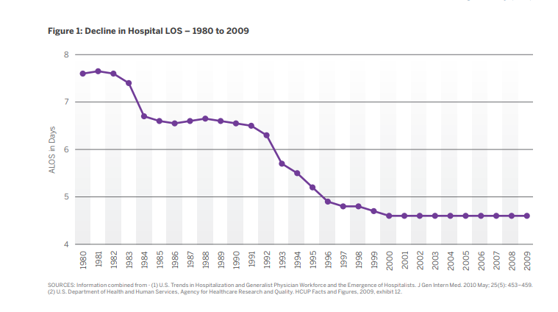
Length of Stay Decreased

Slide 21
DRG in Europe
Countries imported DRG systems from other countries, Ireland, Portugal, and Spain
Countries customized DRG, Nordic countries
Developed their own DRG, Austria, England, and the Netherlands
Notes:
Countries imported DRG systems from other countries, Ireland, Portugal, and Spain from the US and Australia
Countries customized DRG
Developed their own, Austria, England, and the Netherlands

Slide 22
Slovenia

Slide 23
Slovenia: DRG Lessons Learned
From 2003‐2008 the hospitalization rate in acute care increased by 12.6% (with a 1.66% average yearly growth), which was achieved with improved cost efficiency.
Due to long‐term positive financial consequences of the model of acute hospital on the basis of DRGs in 2005 the Ministry of Health proposal to increase the volume of acute inpatient care for 2% without additional financial resources was accepted at the partners' level.
The number of waiting patients decreased by 31% from 2003 till 2008.
Average Length of stay declined by 1.22 days.
The average number of diagnoses per case increased in year 2005 by 0.64 diagnoses or by 29.9% and 6.82 procedures compared with year 2003.

Slide 24
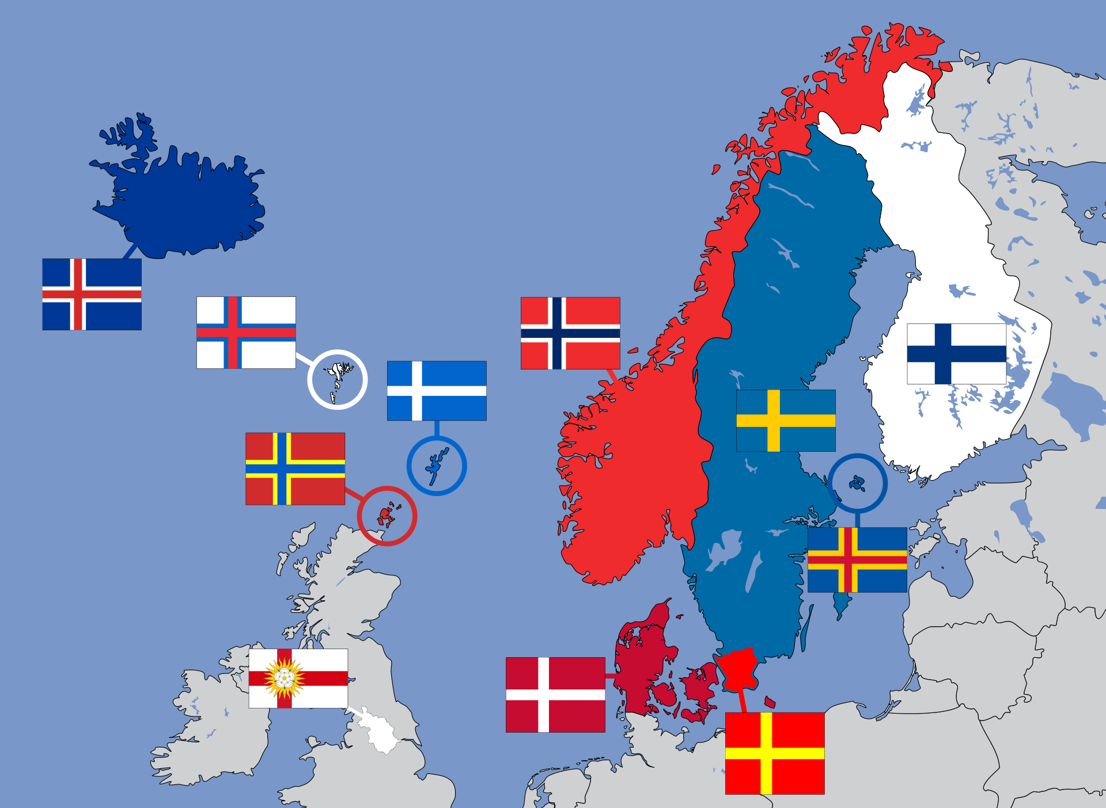
Nord DRG
Sweden
Norway
Finland
Estonia

Slide 25
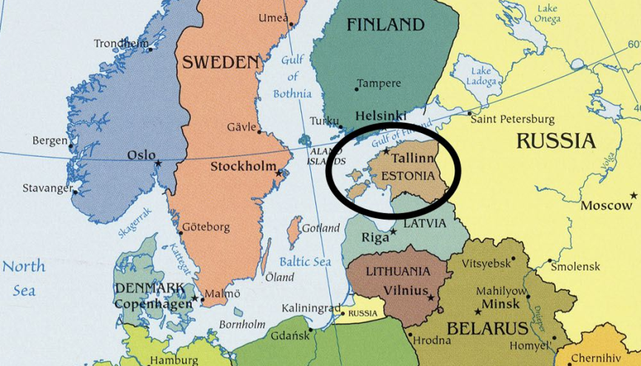
Estonia

Slide 26
Estonia DRG Lessons
DRGs are not for punishing providers but to try to find win-win solutions.
If you are sure that DRGs are important for your system, don’t be stuck on methodological and classification problems.
Involve partners and provide training, but don’t be disappointed if there is no interest
Physicians don’t like coding
Prices were calculated based on HCFA Cost-weights

Slide 27
Europe DRG Trends
Countries are trying to integrate incentives to improve quality into their payment systems
Several European countries are extending DRG to outpatient services
Developing bundled payment systems to align incentives across multiple providers

Slide 28
Australia AR- DRG

Slide 29
AR DRG Implementation Impact (1990-2012)
Uses ICD-10 AM
An increase in public expenditures for inpatient stays.
The share of public expenditure for inpatient care as a percentage of GDP increases from 2.6% in 1990 to 3.2% in 1997 and from 3.2% in 1998 to 3.8% in 2012.
The number of hospital beds decreased by 14% , and there was also a slight increase in hospital discharges in the same period.

Slide 30
Thailand
Payment methods | Provider Behaviors
Primary healthcare services
Fee for services | Increase number of services per patients
Capitation adjusted by age and gender | Treat patient within budge or in worst cases, provide substandard care and exclude high-risk patients, refer patients to specialists and other hospitals
Capitation-fee-for services-mix | Treat within budge and increase number of fee-based services
Hospital admission services
Hospital day | Increase number of admissions and prolonged patients’ average length of stay
Diagnostic related groups (DRG) | Increase number of admissions, shorten ALOS, select less severe patient-case mix
Source: (Thien, 2012)

Slide 31
Abu Dhabi IR DRG
DRGs expected to increase transparency between hospitals as DRGs will simplify costs and quality comparisons between hospitals
DRG was implemented
at the Sheikh Khalifa
Medical City (SKMC)
in 2011 with 3M
system providers
share some of the financial risks with the payer
At SKMC, there was no noticeable increase in mortality nor readmissions after applying DRG

Slide 32
Pricing DRGs in Abu Dhabi
HAAD evaluated the cost of DRG based on the claim data from all hospitals in Abu Dhabi.
To prevent readmissions for the same procedures, HAAD implemented a quality program called JAWDA (Tasneef, 2016). If the same patient readmitted within one month the first provider will be questioned.

Slide 33
Abu Dhabi DRG Utilization
Public Hospitals claimed more than 70% of the medical DRGs.
For surgical DRGs, the distribution was equal between private and public.
DRGs adaptation by AUH hospitals can increase their profit margins by getting the maximum appropriate reimbursements.
DRG can lead to reduction in length of stays which if done properly can lead to reducing nosocomial infections.
DRGs system may lead to early discharges, which increase the readmission rate for the same indication within thirty days of discharge.

Slide 34
Global DRG implementations: key benefits and challenges
Improvements in efficiency and Length of stay
Can lead to a financial system that encourages early discharges which can be against best clinical priorities.
Coding is a challenge and you need to train physicians on it.
Pricing is a challenge, but you need to have a fair system.

Slide 35
Unintended Consequences of DRG Implementations
Cherry picking
Up-coding
Increase in unneeded inpatient stays to cover diagnostic and other outpatient services
Excessive reduction in Length of stay (LOS) and quality of care

Slide 36
What to Expect in Dubai?
DHA is planning to roll out IR DRG in 2019 and is based on CPT codes
DRG requires a lot of coding. Need to change payment codes
Hospital are required to buy 3M coding system, which may increase the costs for hospitals
3M to calculate the base rate and relative weights for each DRG based on Dubai claims data.
IR-DRGs group each hospital stay into only one DRG for case-mix classification and payment purposes
Physicians training is required
LOS of stay is expected to decrease
Hospitals might start to cherry pick.
Need to watch readmission for the same procedure

Slide 37
What to expect? (continue)
Utilization review and medical necessity review by health insurance companies will be simplified by reducing the number of units of service billed
Allows flexibility for negotiations on DRG prices between health insurance companies and hospitals
Insurance companies can better budget and forecast payments to hospitals

Slide 38
Thank You
Ahmad Okasha, Ph.D.
A.okasha@cud.ac.ae

Slide 39
References
Barry D. Alexander et al., Medicare, in FUNDAMENTALS OF HEALTH LAW 81, 111 (American Health Lawyers Association 5th ed., 2011).
Frankford, D. 1993, The Medicare DRGs: Efficiency and Organizational Rationality, Yale Journal on Regulation, (273-346)
https://www.verywell.com/drg-101-what-is-a-drg-how-does-it-work-3916755

Slide 40
